Slide 1
Amberg IMS Survey Overview

Slide 2
Content
Starting point
What is IMS Survey?
Different use cases
System configurations
Measurement workflows
Data processing, analysis and reporting/export
2

Slide 3
Starting point (1)
IMS Systems: IMS 1000 / 3000
Measurement method established in market (especially from VMS systems)
Highly efficient track surveying
Still high accuracy reachable
Limitation today
Necessity of having design data available during survey and for processing
Track situation
Most tracks without actual design data
Track owner aware of benefits of regular 3D track surveying for Track-LCC
3

Slide 4
Starting point (2)
Conclusion
IMS System can not yet be used under all desired project conditions
Existing track without design data shall be measured and evaluated efficiently
This fact requires a new application
➔ IMS Survey
4

Slide 5
What is IMS Survey?
Characteristics
Usage of high-performance IMS long-chord principle
Enabling high performance track survey with subsequent data processing and visualisation, even with no or only reduced design data
From evaluation of inner track geometry (e.g. versines) up to absolute 3D track geometry
Different application use cases now available
5

Slide 6
IMS Survey – Use case 1
Instant / One-off Inner Track Geometry Assessment
Determination of inner track geometry of a(n) (unknown) track section
Visualisation and analysis of inner track geometry with TGR
Reference stationing might be available (optional)
Reproducibility only possible with known stationing
B
(km)
A
6

Slide 7
IMS Survey – Use case 2
Inner Track Geometry Assessment & Monitoring
As Use Case 1, additionally:
Use of lasting stationing references
Base for repeatable measurement campaigns
Design (= derived from initial survey) vs. As-built (= subsequent survey) comparison
Versines
Gauge
Superelevation
Twist
B
km
km
km
A
7

Slide 8
IMS Survey – Use case 3
Local 3D Topographic Survey
Setup and survey of local track reference points (CPs) during initial measurement run
Track survey in between CPs in local 3D grid (Origin of local coordinate grid = Start of track)
Results can be used for
Local track design & track works
Monitoring design vs. as-built comparison
X
Track
CP
(Hor. / vert. offset)
Reduced Coordinate Consistency and Coordinate Grid Quality
Y
8

Slide 9
IMS Survey – Use case 4
Global 3D Topographic Survey
As Use Case 3, additionally:
CPs established in Global Coordinate Grid
Base for
a) Subsequent transformation of local 3D track data
or
b) Initial survey directly using 3D CP project data
N
Track
CP
(E/N/H)
Consistent Coordinate Grid Quality
Fully compatible with other geodetic 3D survey data
E
9

Slide 10
IMS Survey – Summary of use cases
Use case | Short description
1 | Instant / One-off Inner Track Geometry Assessment
2 | Inner Track Geometry Assessment & Monitoring
3 | Local 3D Track Assessment
4 | Global 3D Track Assessment a) Subsequent transformation with 3D CPs b) Initial survey directly using 3D CPs / GNSS
10

Slide 11
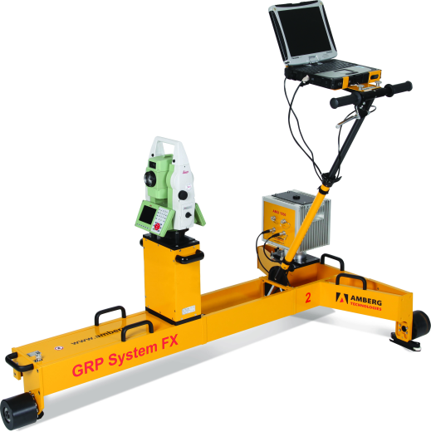
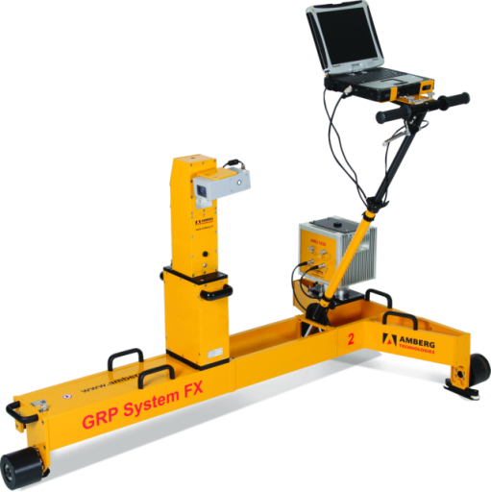
System configurations (1) IMS 1000 / 3000
IMS 1000
IMS 3000
GRP System FX
AMU 1030
Leica total station (TS15/16/ 30/50/60, MS50/60)
GNSS Option
GRP System FX
AMU 1030
Amberg Profiler 110 FX
GNSS Option
11

Slide 12
System configurations (2) IMS 1000 / 3000 – fixed-point measurement device
IMS 1000 – Tachymeter
Integrated Leica Tachymeter
TS15/16/30/50/60 / MS50/60
ATR, motorised
Visible laser beam
Automatic fixed-point measurement
Fixed-point accuracy
Prism: +/- 1 mm
Reflectorless: +/- 1.5 mm
IMS 3000 – Profiler 110 FX:
Manual fixed-point measurement
Fixed-point accuracy +/- 3 mm
Visible red laser allowing reflectorless measurement
12

Slide 13
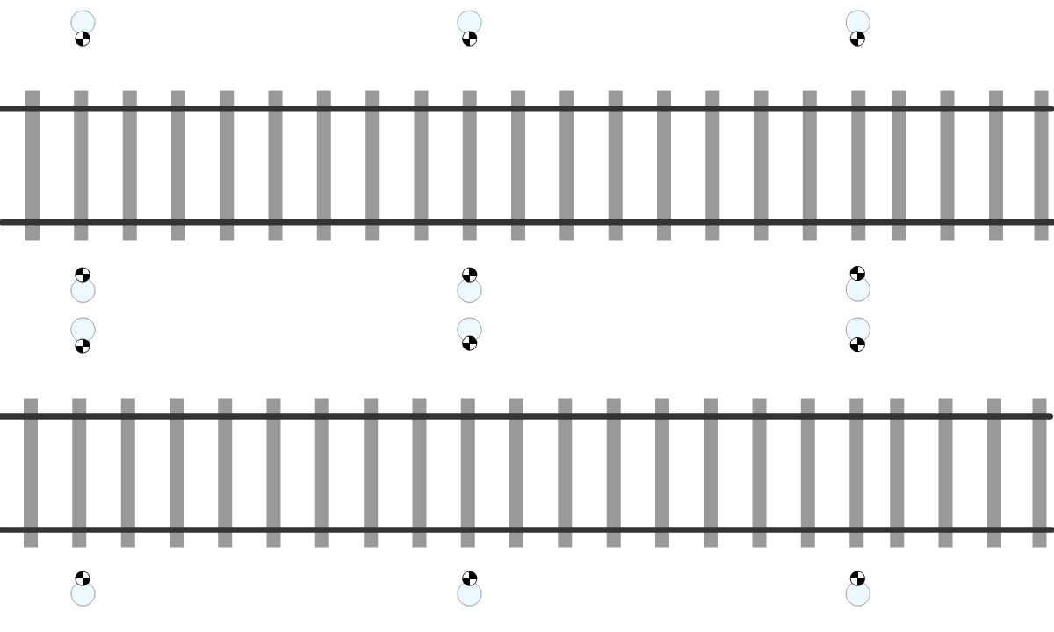
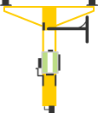
Measurement method (1) IMS 1000 / 3000 – Use cases 1+2
Speed up to 5 km/h
Start measuring at known stationing reference (optional)
Kinematic acquisition of inner track geometry
Update of stationing references (if available/desired)
Inner track geometry accuracy: 1 mm for 150 m chord length
KM
127
1
KM
127
2
KM
127
3
KM
127
4
KM
127
5
13

Slide 14
Measurement method (2) IMS 1000 / 3000 – Use case 3 + 4 b)
Speed up to 4 km/h
Start measuring at known 3D CP or newly established CP
Measure offsets to CPs using P110 / TPS
Kinematic data acquisition, exception: short stops for CP measurements
Process track data with 3D CPs or newly established CPs
3D CP
3D CP
3D CP
3D CP
3D CP
Repeat accuracy [mm] | CP Interval [m]
+/- 1 | < 60 m
+/- 2 | < 120 m
+/- 5 | < 300 m
3D CP
3D CP
3D CP
3D CP
3D CP
14

Slide 15
Measurement method (3) IMS 1000 / 3000 – Use case 4 b)
Combination of
High accuracy inner track geometry coming from IMU
with absolute position from GNSS
As-built survey in absolute coordinate system without any given design data (alignment/CPs)
Creation of control points during initial survey
Simple preparation of future maintenance tasks
Direct BIM/CAD compatibility
15

Slide 16
Data processing, analysis and reporting/export
Simple data flow from measurement computer back into office project thanks to given sub-folder structure
Merging of independent measurement sequences (from different systems and / or different jobs) into one application for further analysis
Fully automated data processing
Data analysis, visualisation, reporting and exporting in existing Amberg Rail track applications
Support of different export formats like ASCII, DXF, LandXML
Use of Track Geometry Record (TGR) application for assessments
16

Slide 17
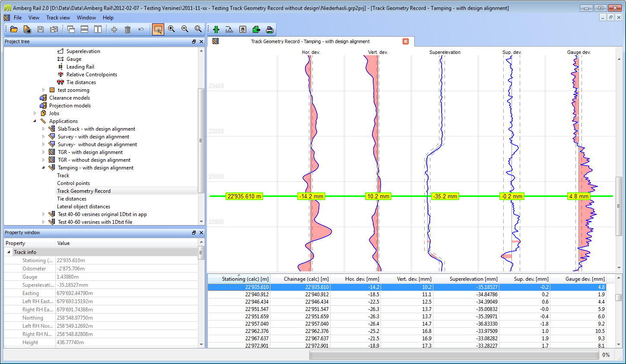
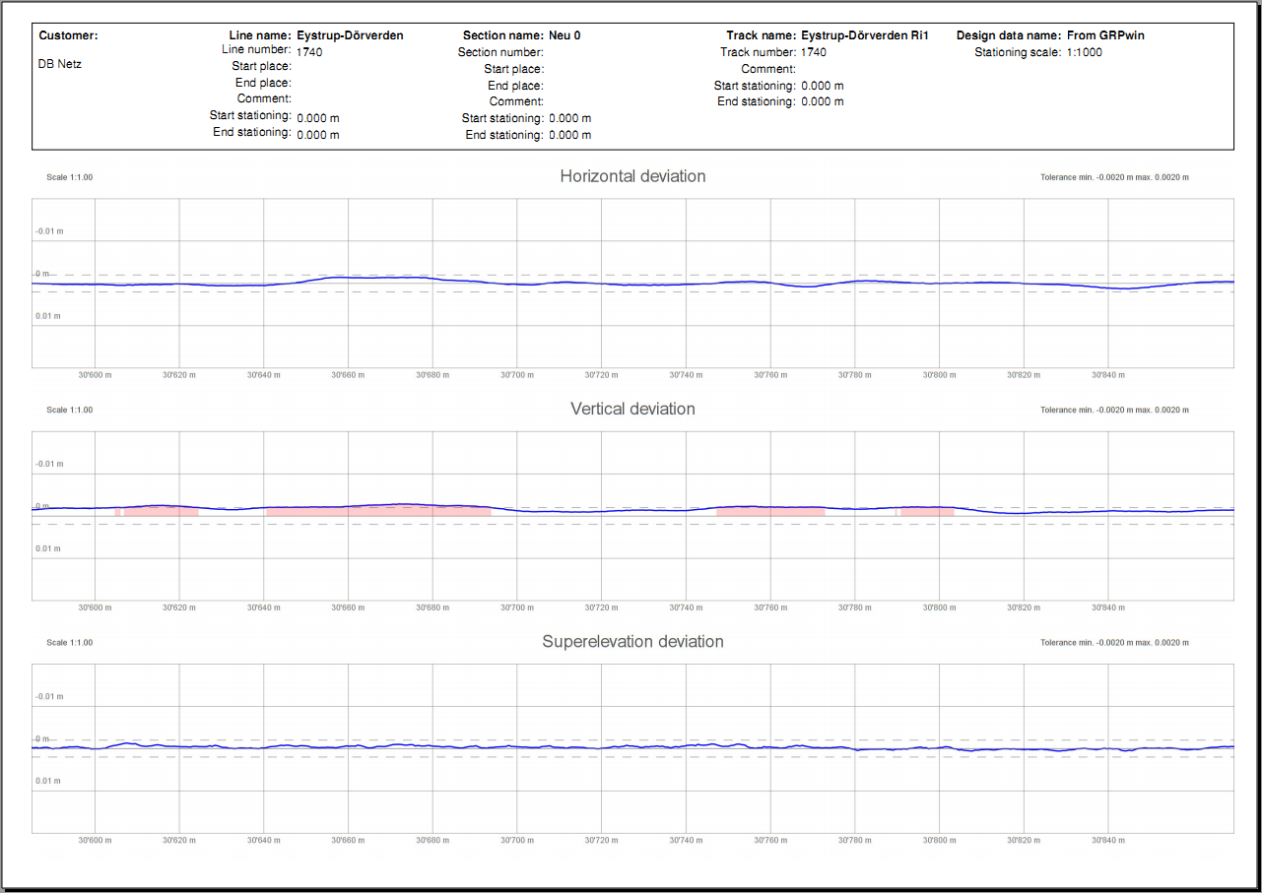
TGR add-on Analysis – Reporting – Exporting
Amberg IMS Survey
TGR – Track geometry record
Add-on for extended track geometry analysis
More than 80 track parameter incl.
Gauge, cross level (cant), twist, curvature, versines, a.o.
Nominal-actual deviations
Change of deviations
Graphically presented as configurable measuring trace
Comprehensive reporting incl. scaled diagram plots
17

Slide 18
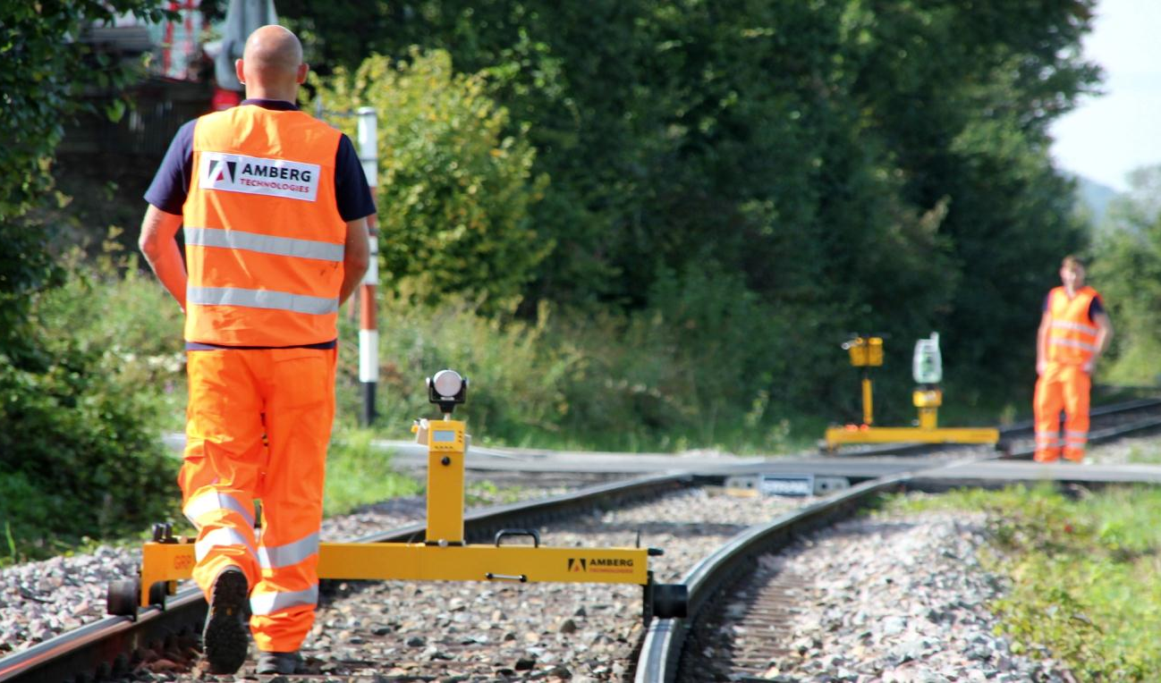
Amberg Rail 3.0
Railway Surveying for Professionals
How can we help you?
Please contact Amberg Technologies or our local distribution partner:
www.ambergtechnologies.com
e-mail: rail@amberg.ch / support.rail@amberg.ch

